Slide 1
Periodic Table
10th Grade
1 H |  |  |  |  |  |  |  |  |  |  |  |  |  |  |  |  | 2 He
3 Li | 4 Be |  |  |  |  |  |  |  |  |  |  | 5 B | 6 C | 7 N | 8 O | 9 F | 10 Ne
11 Na | 12 Mg |  |  |  |  |  |  |  |  |  |  | 13 Al | 14 Si | 15 P | 16 S | 17 Cl | 18 Ar
19 K | 20 Ca | 21 Sc | 22 Ti | 23 V | 24 Cr | 25 Mn | 26 Fe | 27 Co | 28 Ni | 29 Cu | 30 Zn | 31 Ga | 32 Ge | 33 As | 34 Se | 35 Br | 36 Kr
37 Rb | 38 Sr | 39 Y | 40 Zr | 41 Nb | 42 Mo | 43 Tc | 44 Ru | 45 Rh | 46 Pd | 47 Ag | 48 Cd | 49 In | 50 Sn | 51 Sb | 52 Te | 53 I | 54 Xe
55 Cs | 56 Ba | 71 Lu | 72 Hf | 73 Ta | 74 W | 75 Re | 76 Os | 77 Ir | 78 Pt | 79 Au | 80 Hg | 81 Tl | 82 Pb | 83 Bi | 84 Po | 85 At | 86 Rn
87 Fr | 88 Ra | 103 Lr | 104 Rf | 105 Db | 106 Sg | 107 Bh | 108 Hs | 109 Mt | 110 Ds | 111 Rg | 112 Cn | 113 Nh | 114 Fl | 115 Mc | 116 Lv | 117 Ts | 118 Og
 |  | 57 La | 58 Ce | 59 Pr | 60 Nd | 61 Pm | 62 Sm | 63 Eu | 64 Gd | 65 Tb | 66 Dy | 67 Ho | 68 Er | 69 Tm | 70 Yb
 |  | 89 Ac | 90 Th | 91 Pa | 92 U | 93 Np | 94 Pu | 95 Am | 96 Cm | 97 Bk | 98 Cf | 99 Es | 100 Fm | 101 Md | 102 No
Metal
Metalloid
Nonmetal
Recently discovered
Here is where your presentation begins
Wei Lai
Lanthanides
Actinides

Slide 2
Contents
Introduction
History
Shapes

Slide 3
01
Introduction

Slide 4
Periodic table
The periodic table, also known as the periodic table of (the) (chemical) elements, is a tabular display of the chemical elements. It is widely used in chemistry, physics, and other sciences, and is generally seen as an icon of chemistry. It is a graphic formulation of the periodic law, which states that the properties of the chemical elements exhibit a periodic dependence on their atomic numbers.

Slide 5
Reading the periodic table
Atomic Number
Jupiter
6
Symbol
C
Jupiter
Name
Jupiter
Carbon
12.0116
Relavtive Atomic Mass
Jupiter

Slide 6
177 million
is the number of organic and inorganic substances

Slide 7
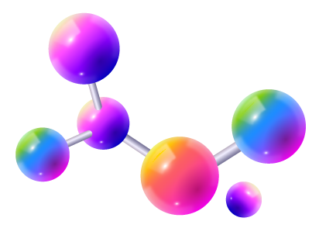
Why do We Need Classification Elements ?
To make things easy we created the periodic table, now called a modern periodic table to understand how the chemistry of this universe works and how elements(atoms) show a sequence with increasing atomic number.

Slide 8

Does the Modern Periodic Table Change? If So, How and Who Does That?
The periodic table as we know it today is managed by the International Union of Pure and Applied Chemistry, or IUPAC (eye-you-pack).

Slide 9
02
History
You can enter a subtitle here if you need it

Slide 10
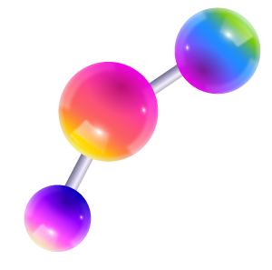
—Tim Hardaway
You have to look at how chemistry develops.

Slide 11
Periodic table timeline
A.E.B. de Chancourtois
Dmitri Mendeleyev
1862
1882
01
02
03
04
05
1829
1865
NOW
Johann Dobereiner
John Alexander Newlands

Slide 12
03
Shapes
You can enter a subtitle here if you need it

Slide 13
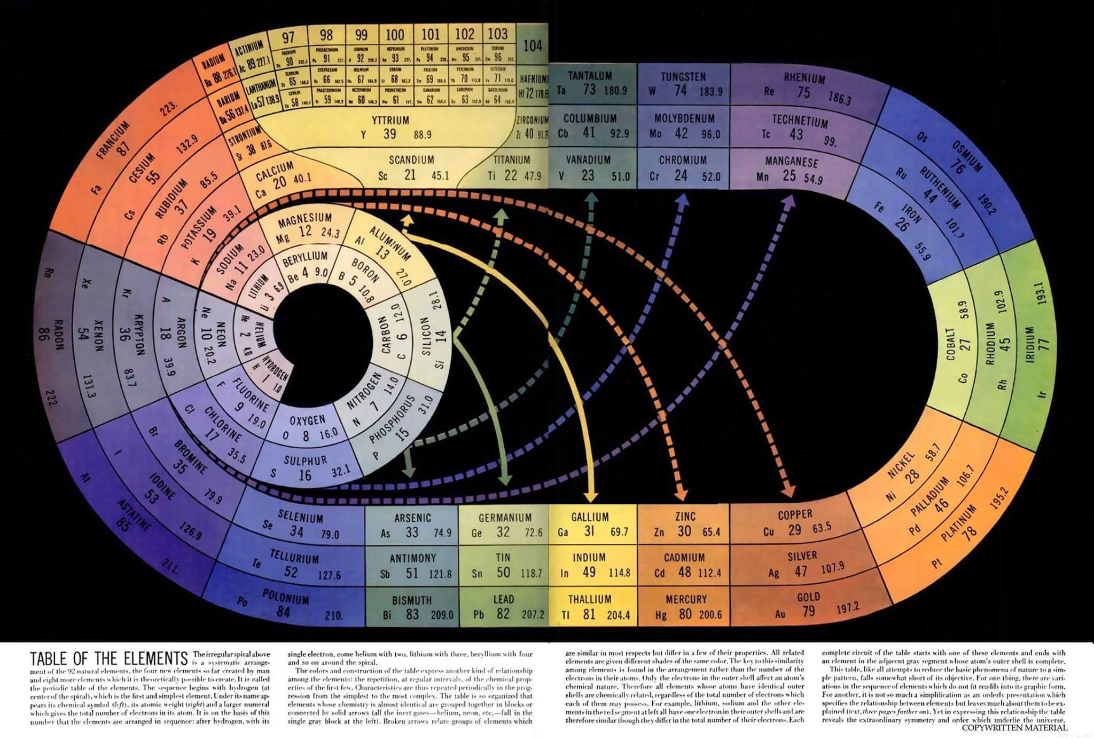

Slide 14
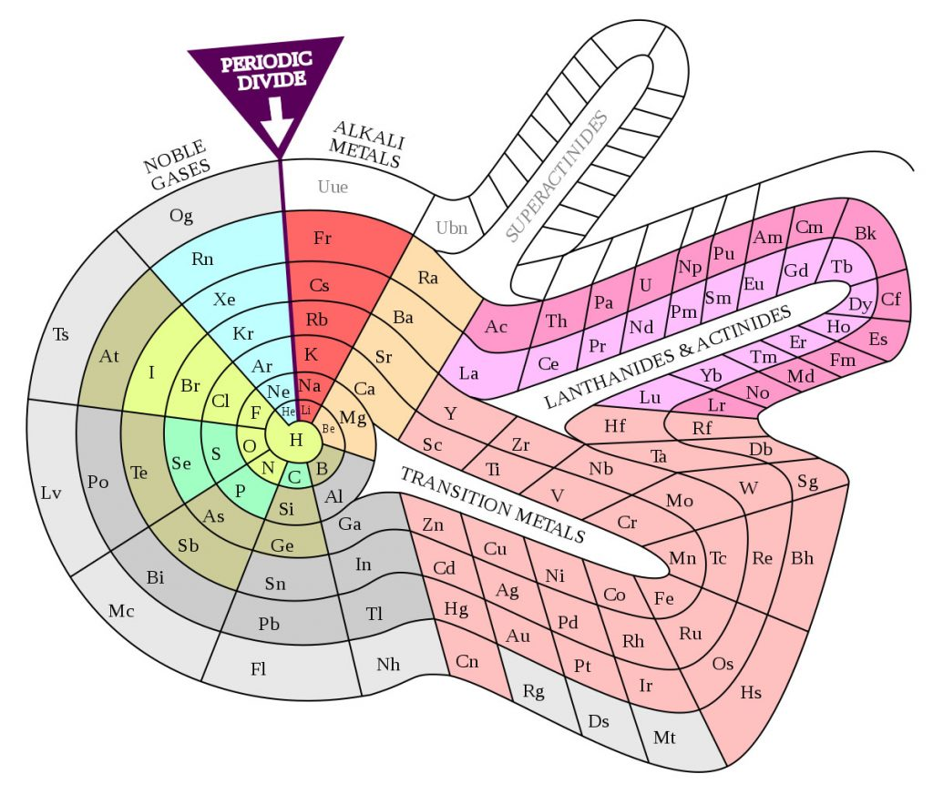

Slide 15
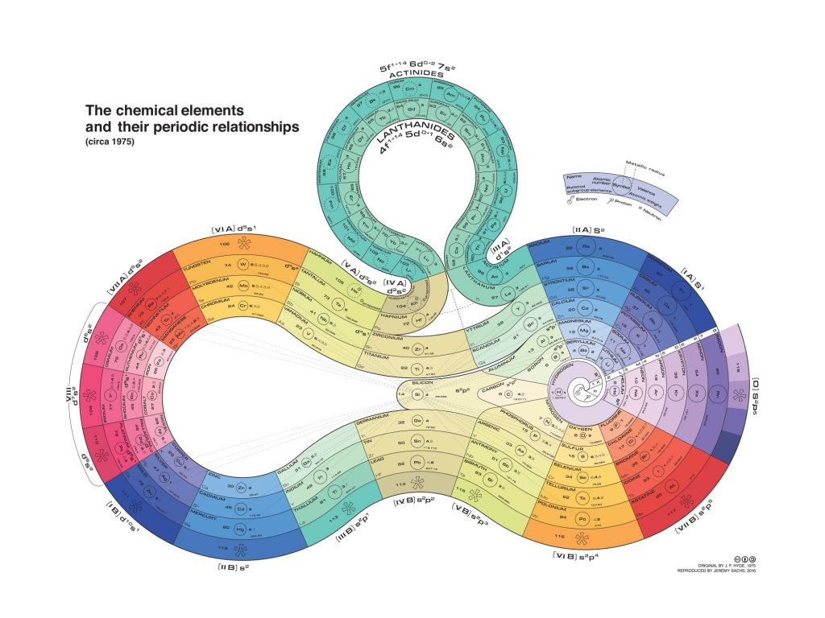

Slide 16
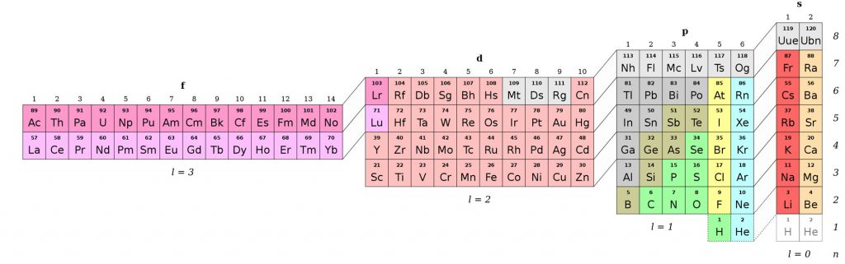

Slide 17
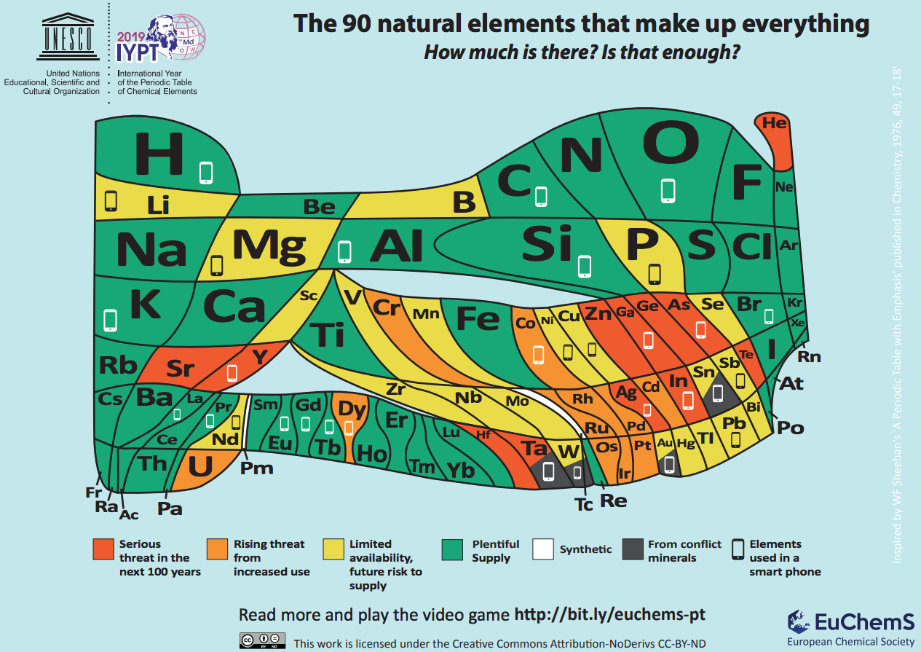

Slide 18
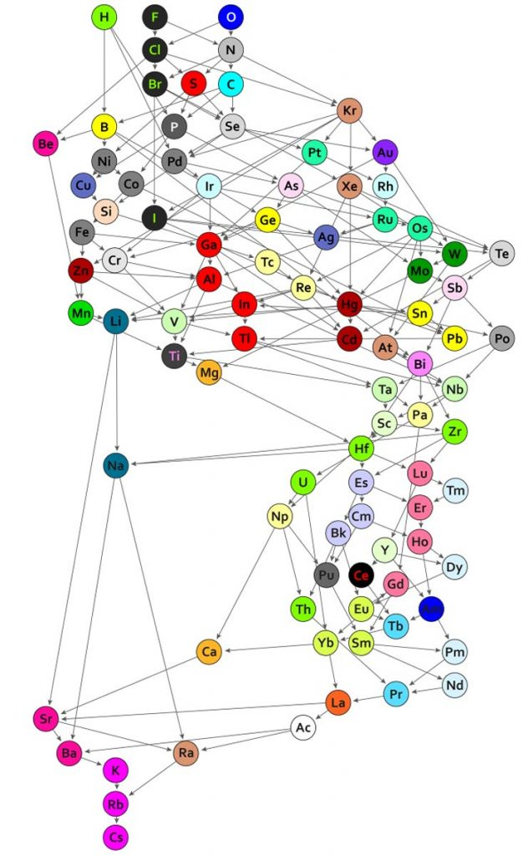

Slide 19

Thanks!

